Slide 1
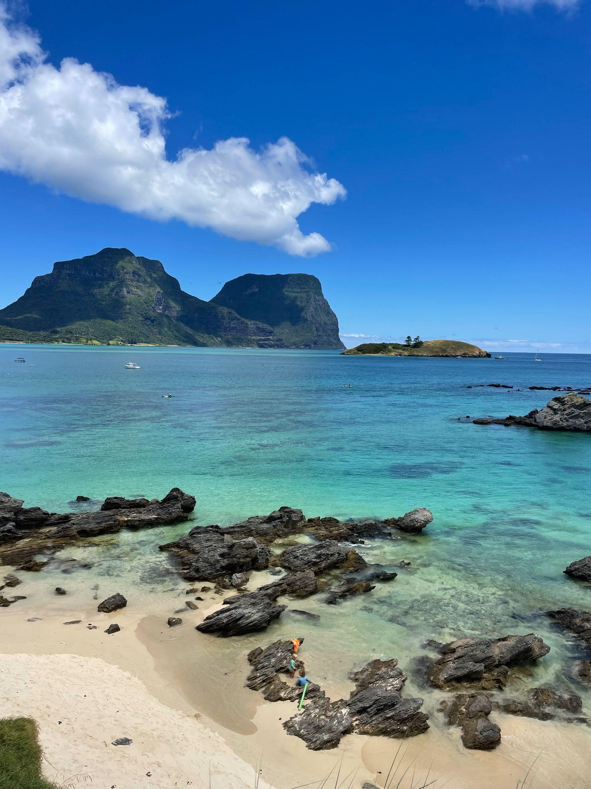
Lorde Howe
Island
2nd - 12th January
Gavin

Slide 2
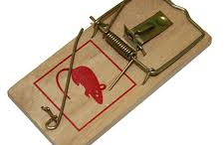
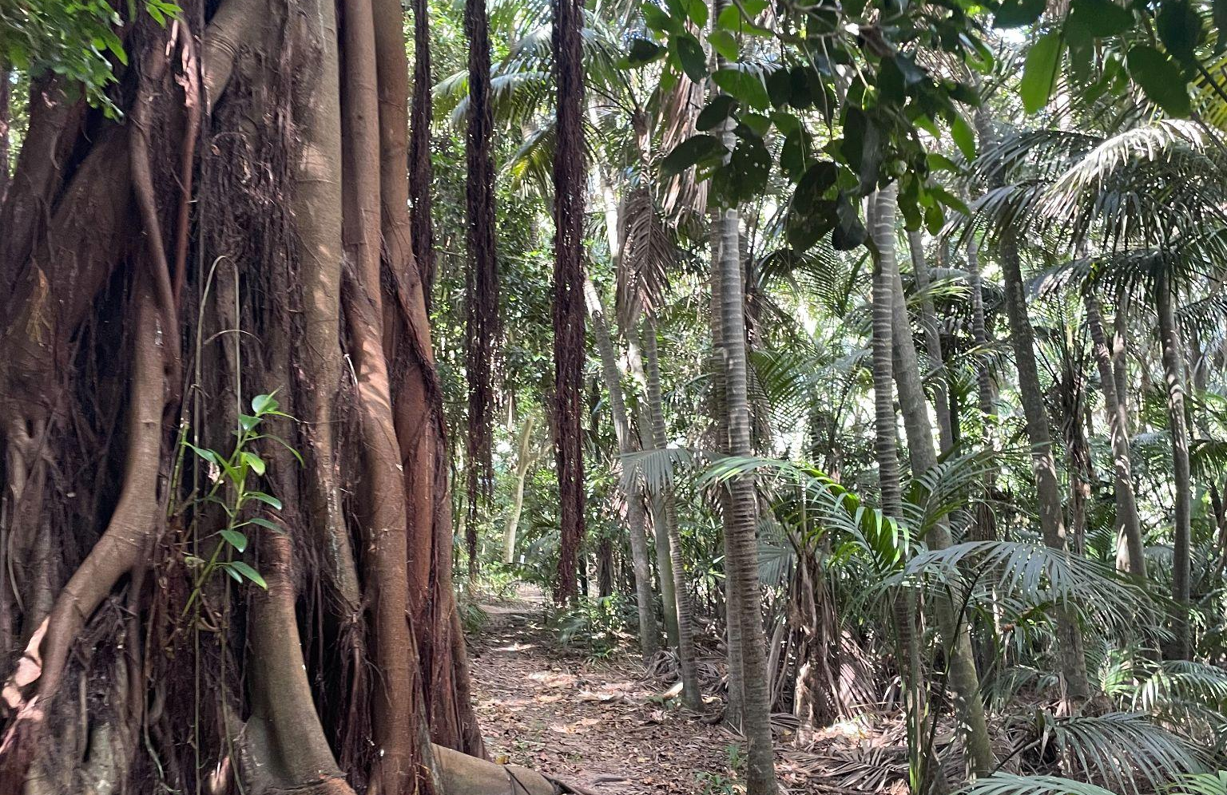
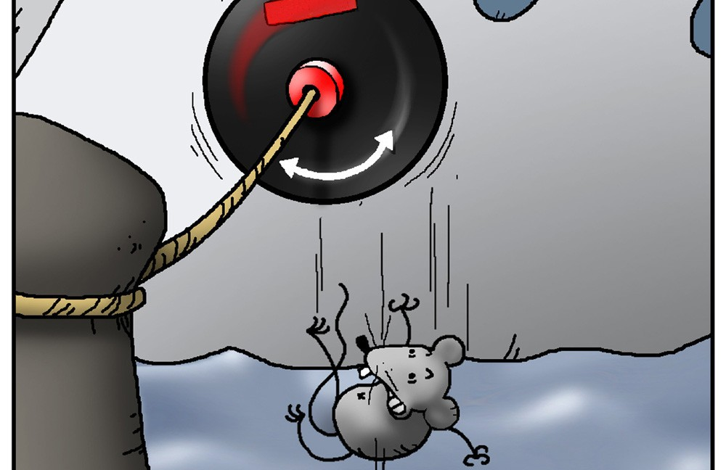
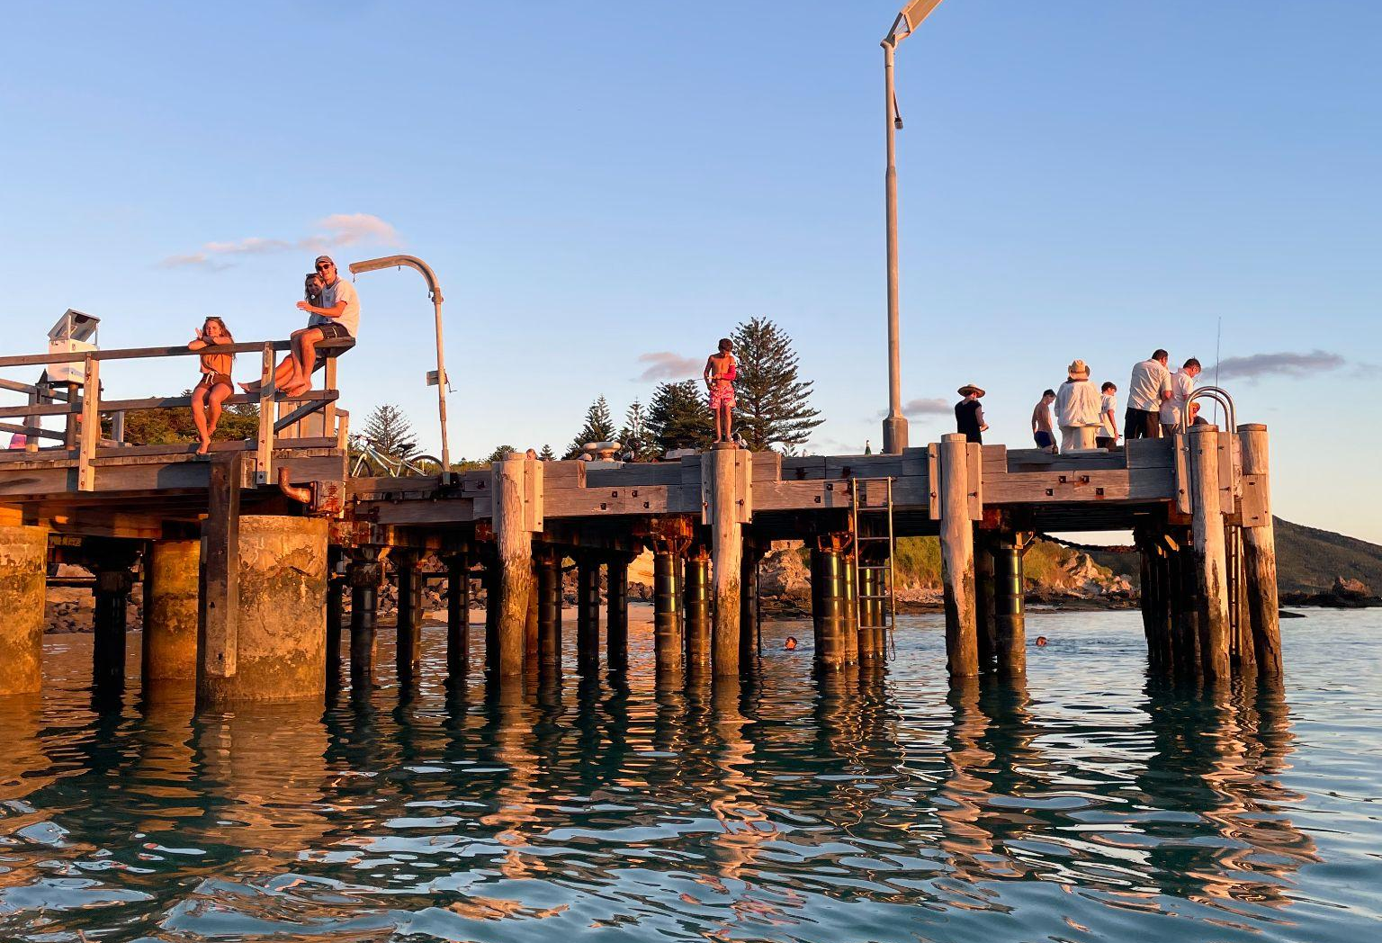
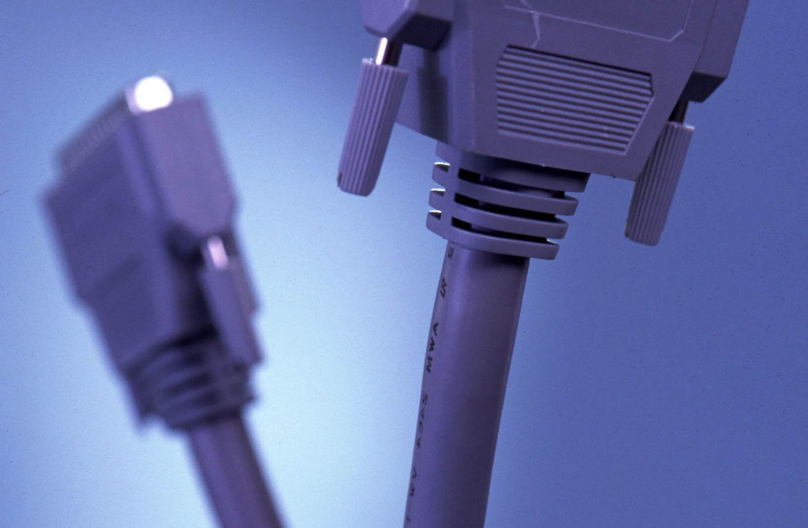
Biosecurity- Before Arrival
A completed Biosecurity Declaration –
usually the last two pages of the form provided by the Island Board.
Rat guards fitted to all mooring lines if you'll tie to a wharf or jetty.
Photos of rodent traps and poison bait stations on board — these must be in place for at least one full week before arrival
A photo of your hull, ideally from above the waterline, and the date it was last cleaned.

Slide 3
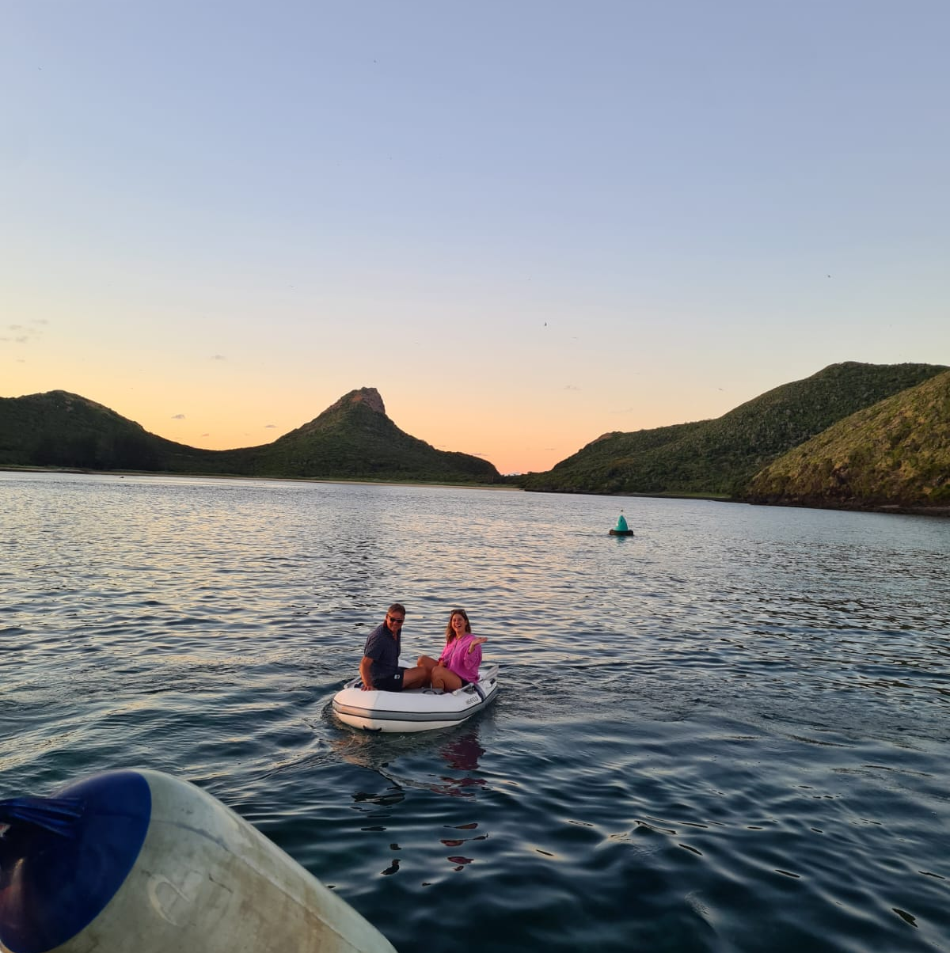
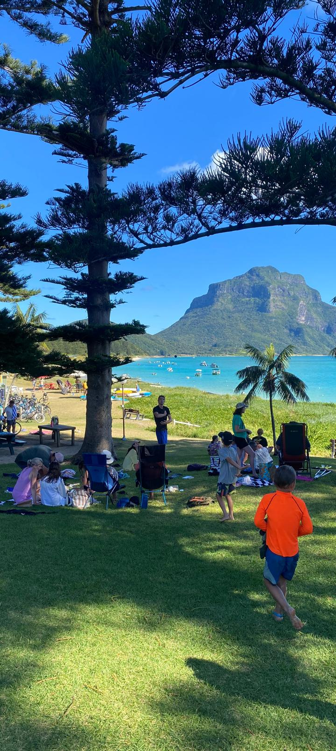
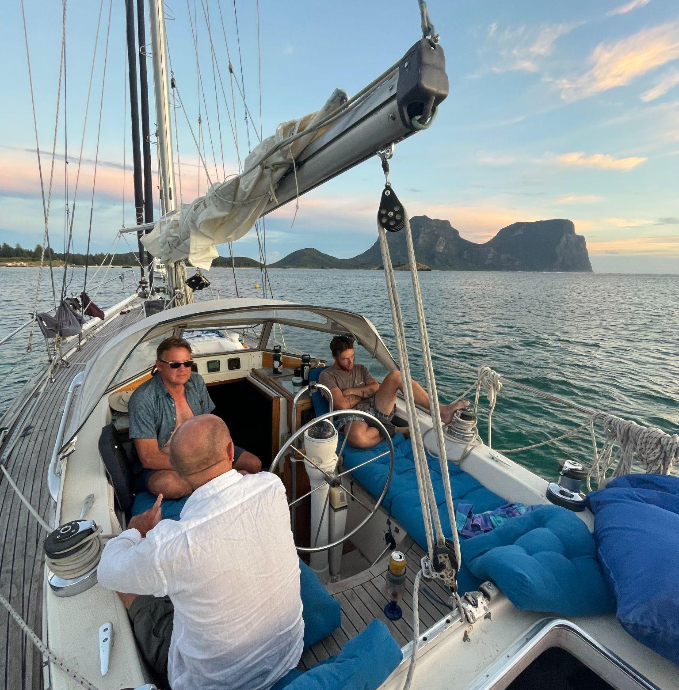
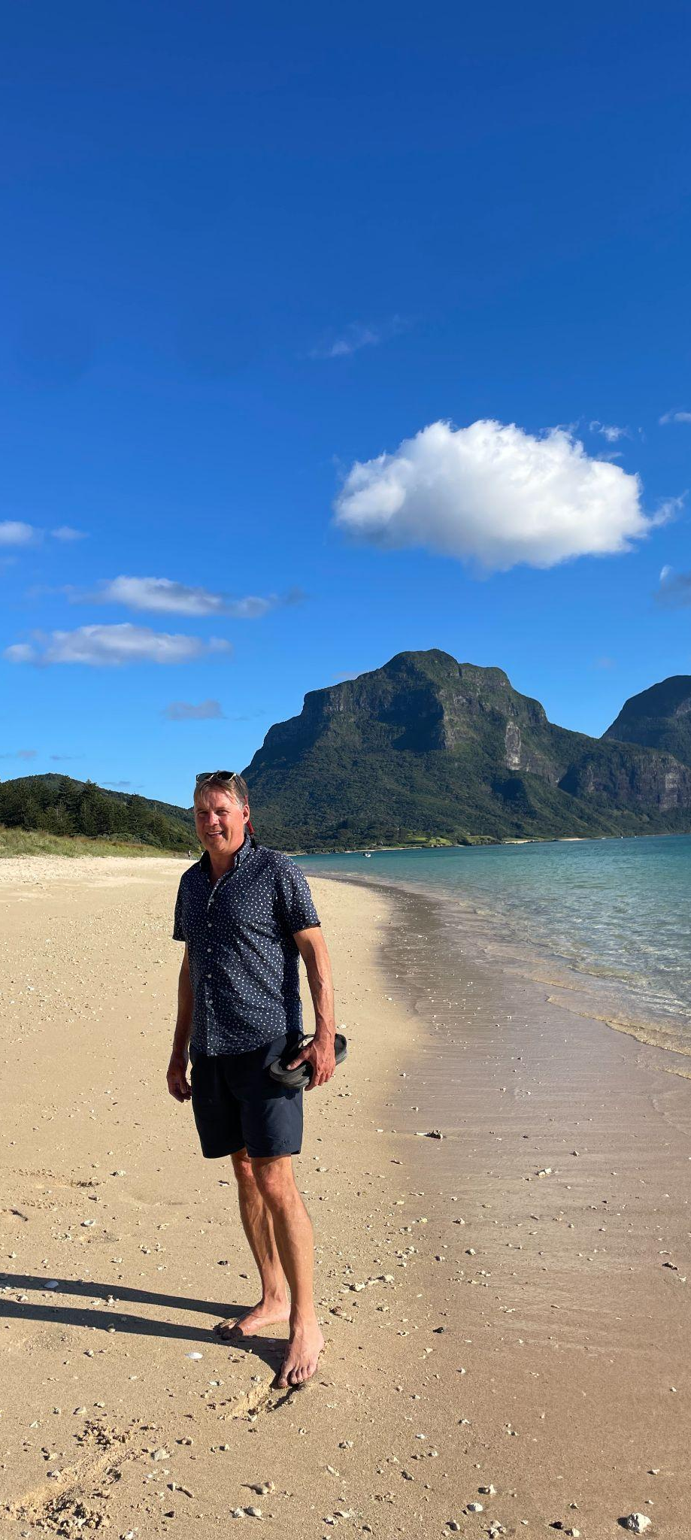
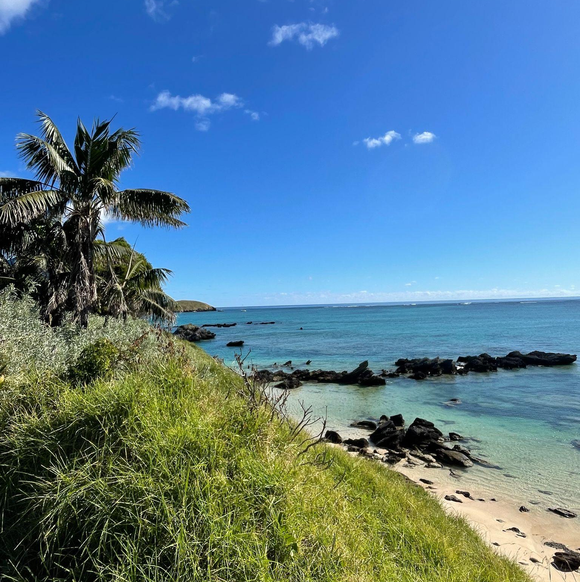
Once you arrive, your yacht will be subject to a biosecurity inspection before anyone can go ashore.

Slide 4
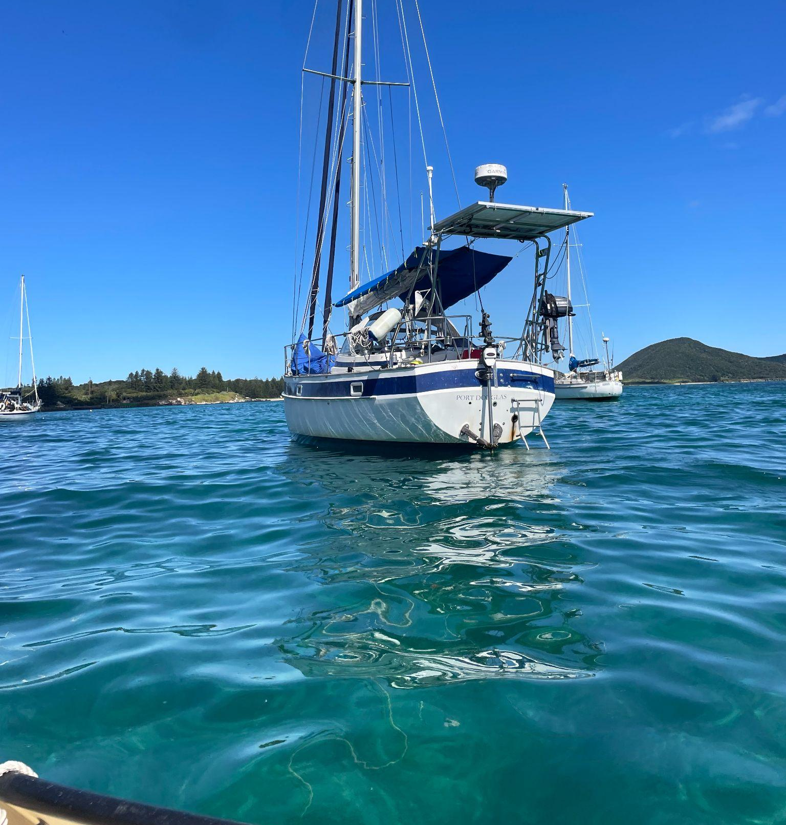
Mooring Costs and Bookings
You must book a mooring in advance. Anchoring is not permitted in the lagoon due to the fragile coral reef system, and entry is only possible at high tide.
And it’s not cheap — the cost breakdown for a 2-night stay: Payment is required in advance , and you’ll need to confirm your ETA before departure.
Fee Type | Amount (AUD)
Mooring Fee (2 nights) | $112.00
Environmental Levy | $192.32
Admin Fee (one-off) | $51.00
Biosecurity Fee | $98.00
Total | $453.32

Slide 5
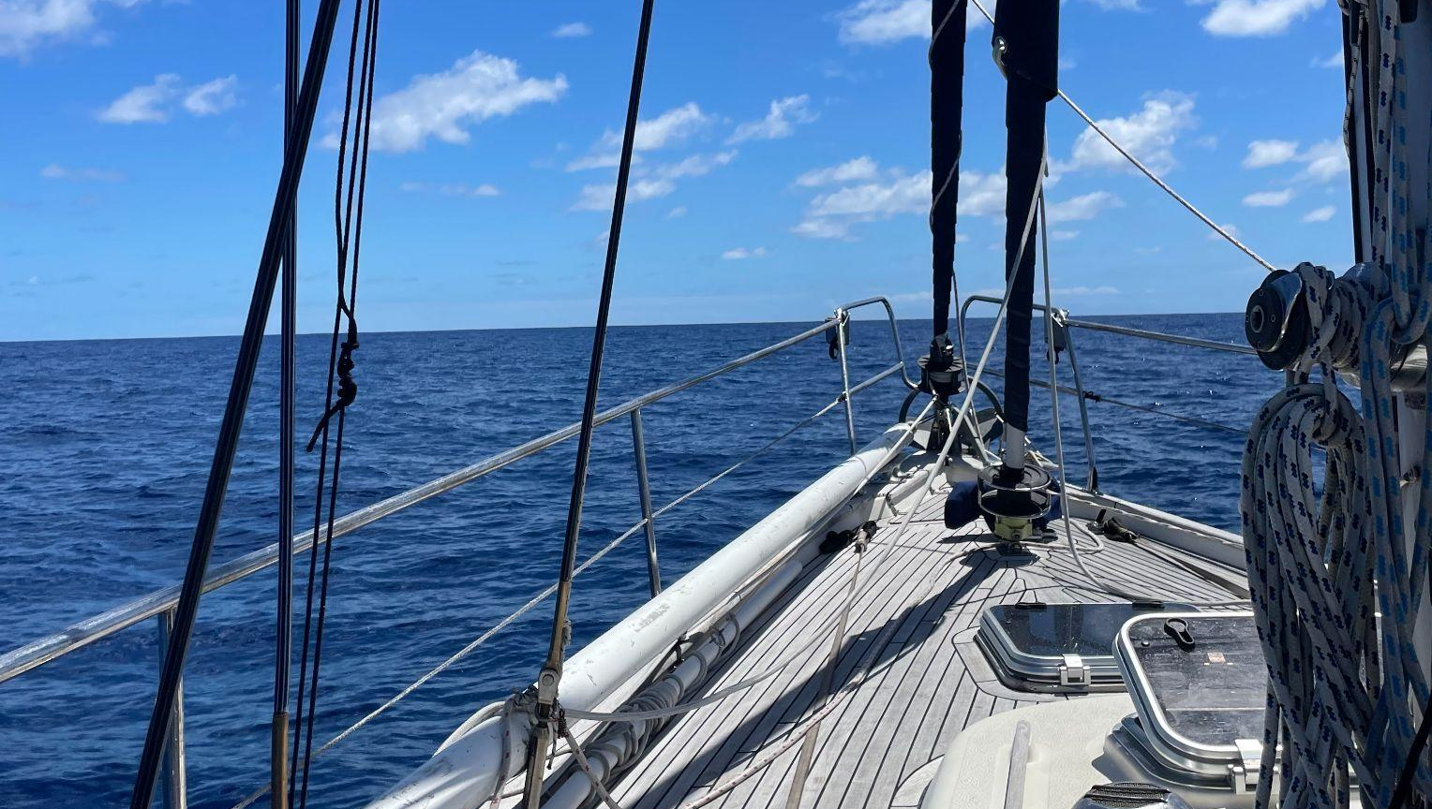

Let’s connect!
Share your contact information.
This can be your work email, your LinkedIn profile, your phone number – wherever you want team members to reach out.

Slide 6
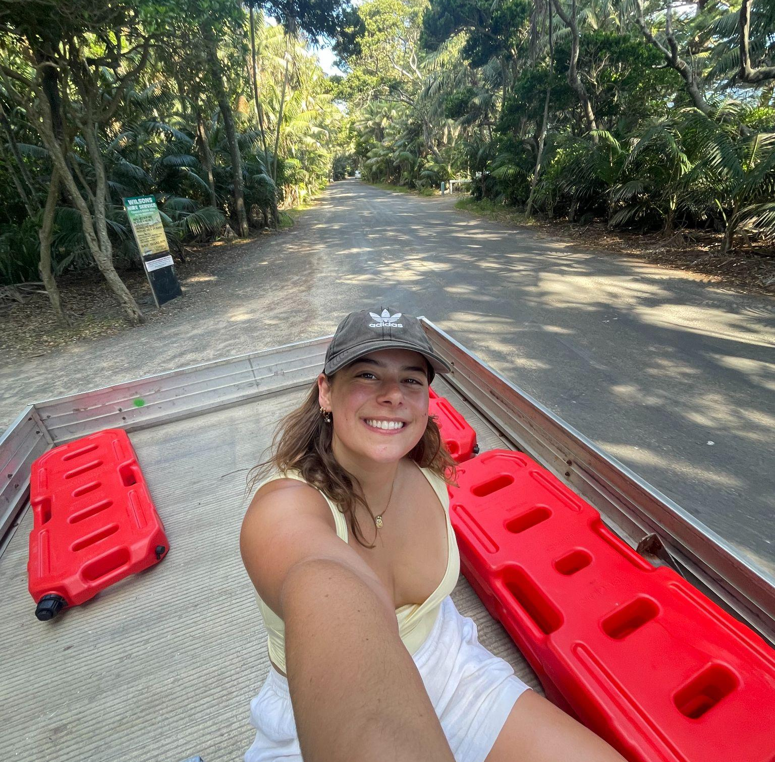
Fuel/Petrol Access on the Island
Fuel access is… a bit rustic. It involves a trip in the back of the truck up to the depot.
Expect to transfer fuel by jerry can, and check in advance about operating hours and payment methods — supplies are limited and can be expensive.
They/Them

Slide 7
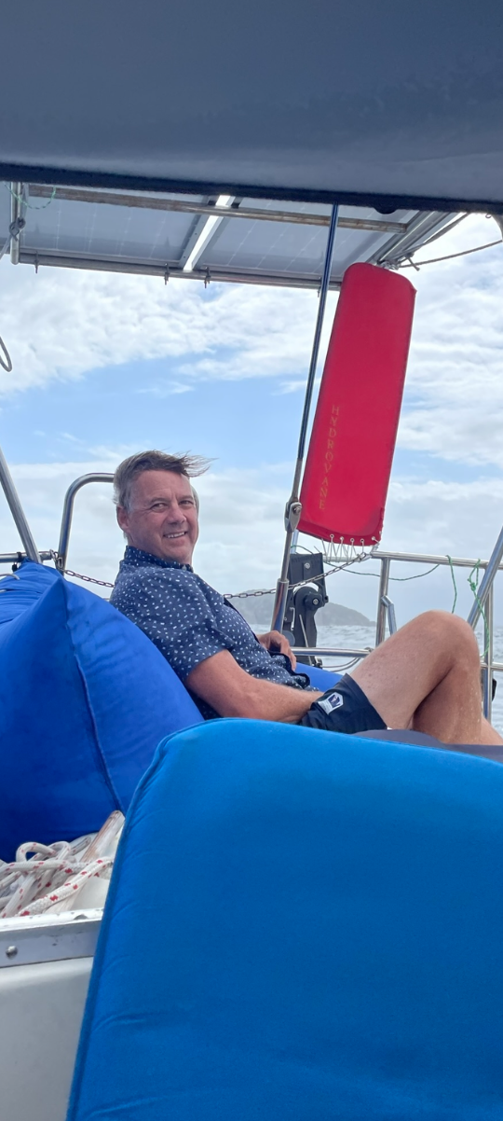
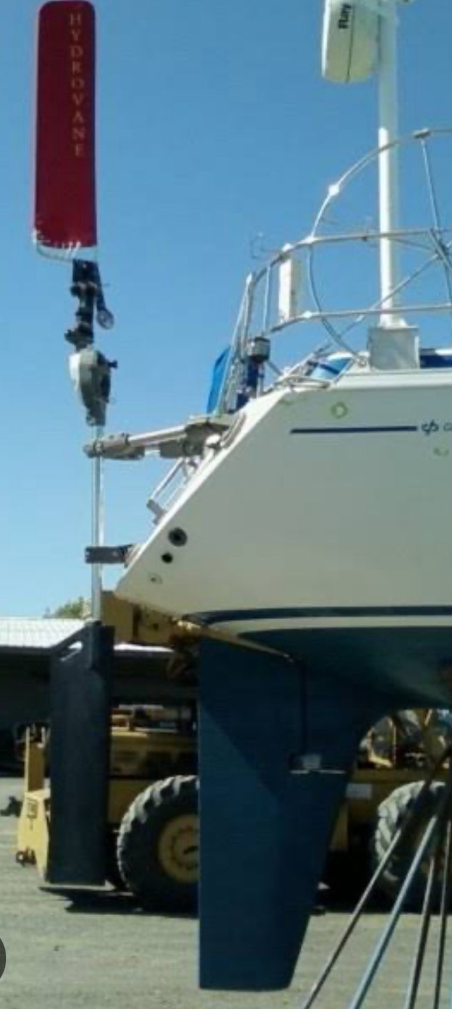
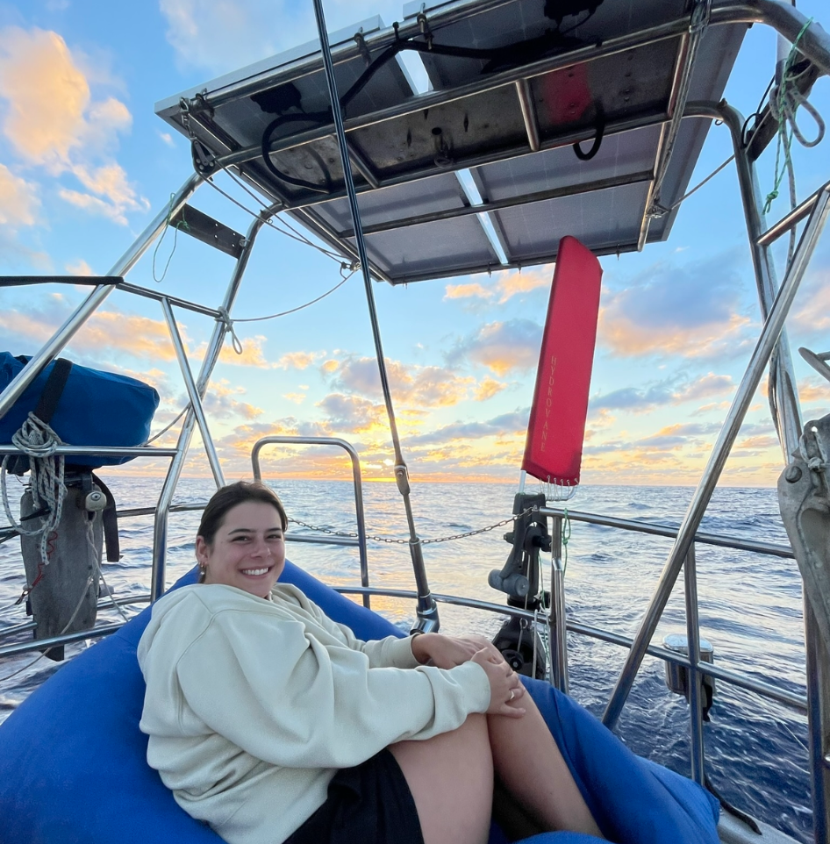
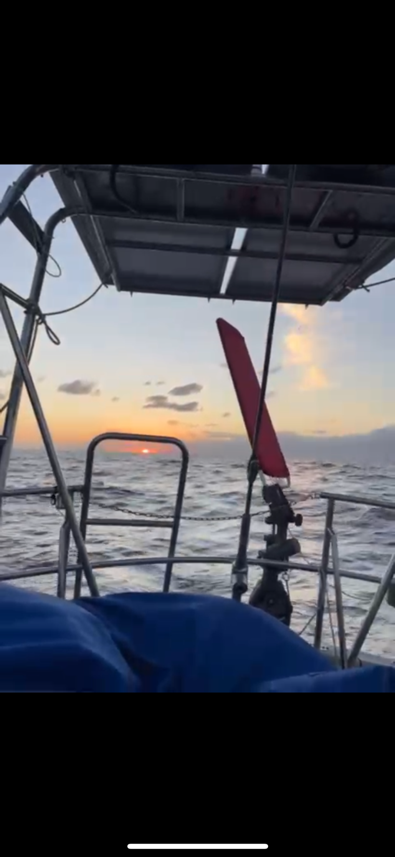
Hydrovane

Slide 8
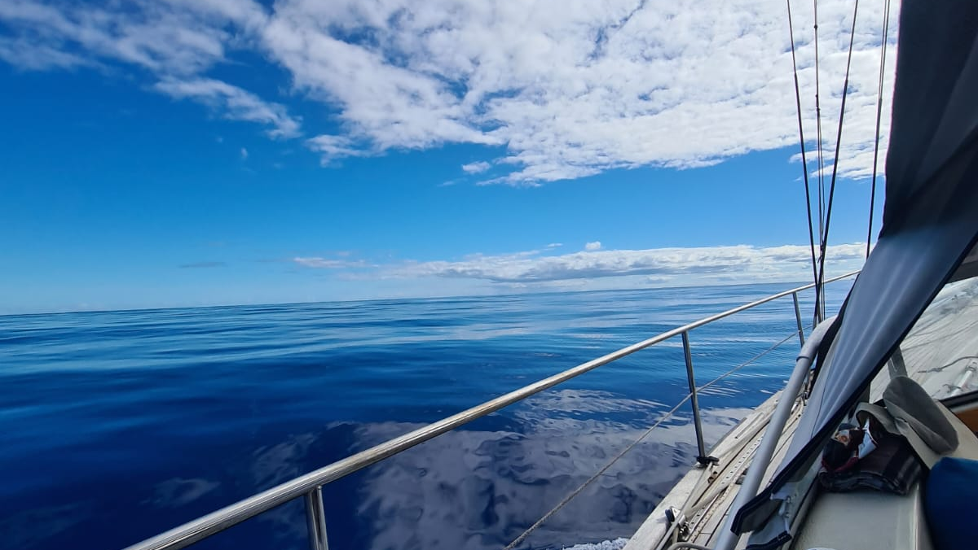
Sailing the
Passage

Slide 9
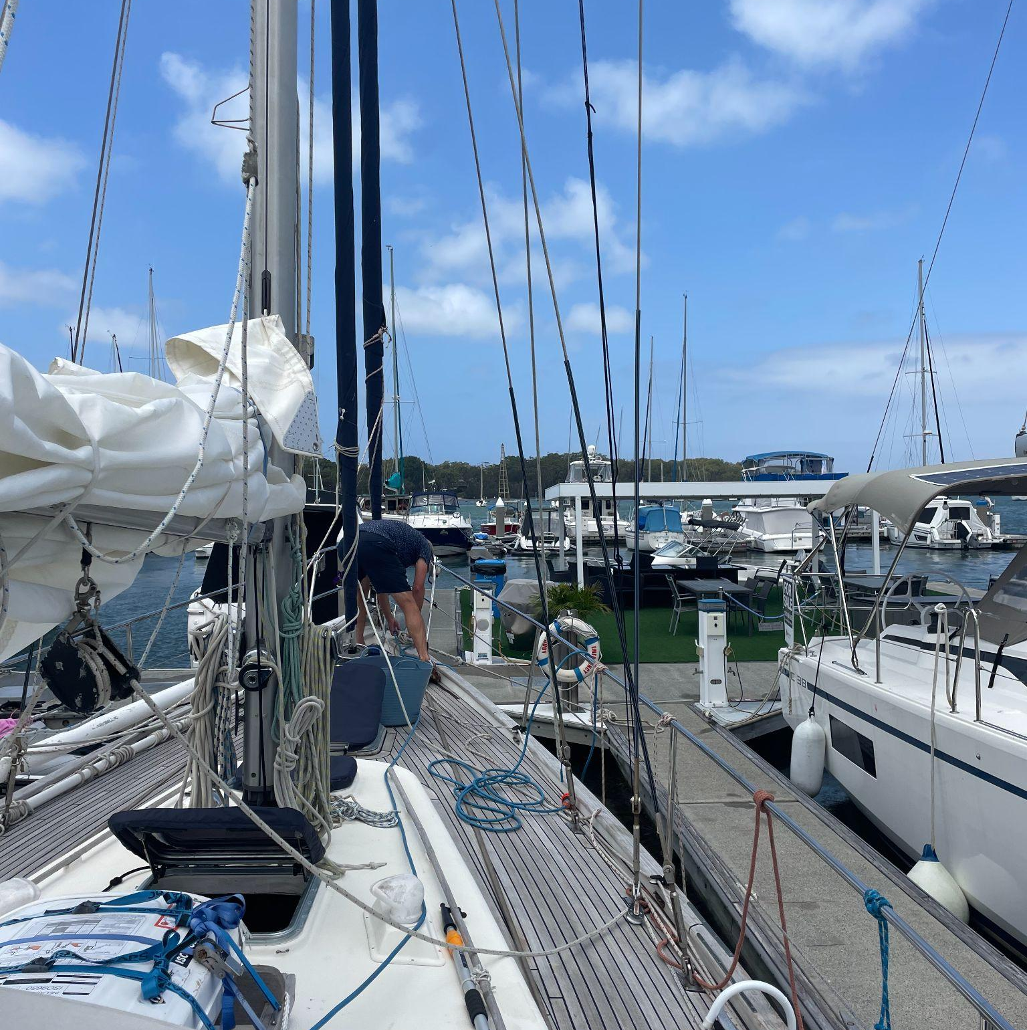
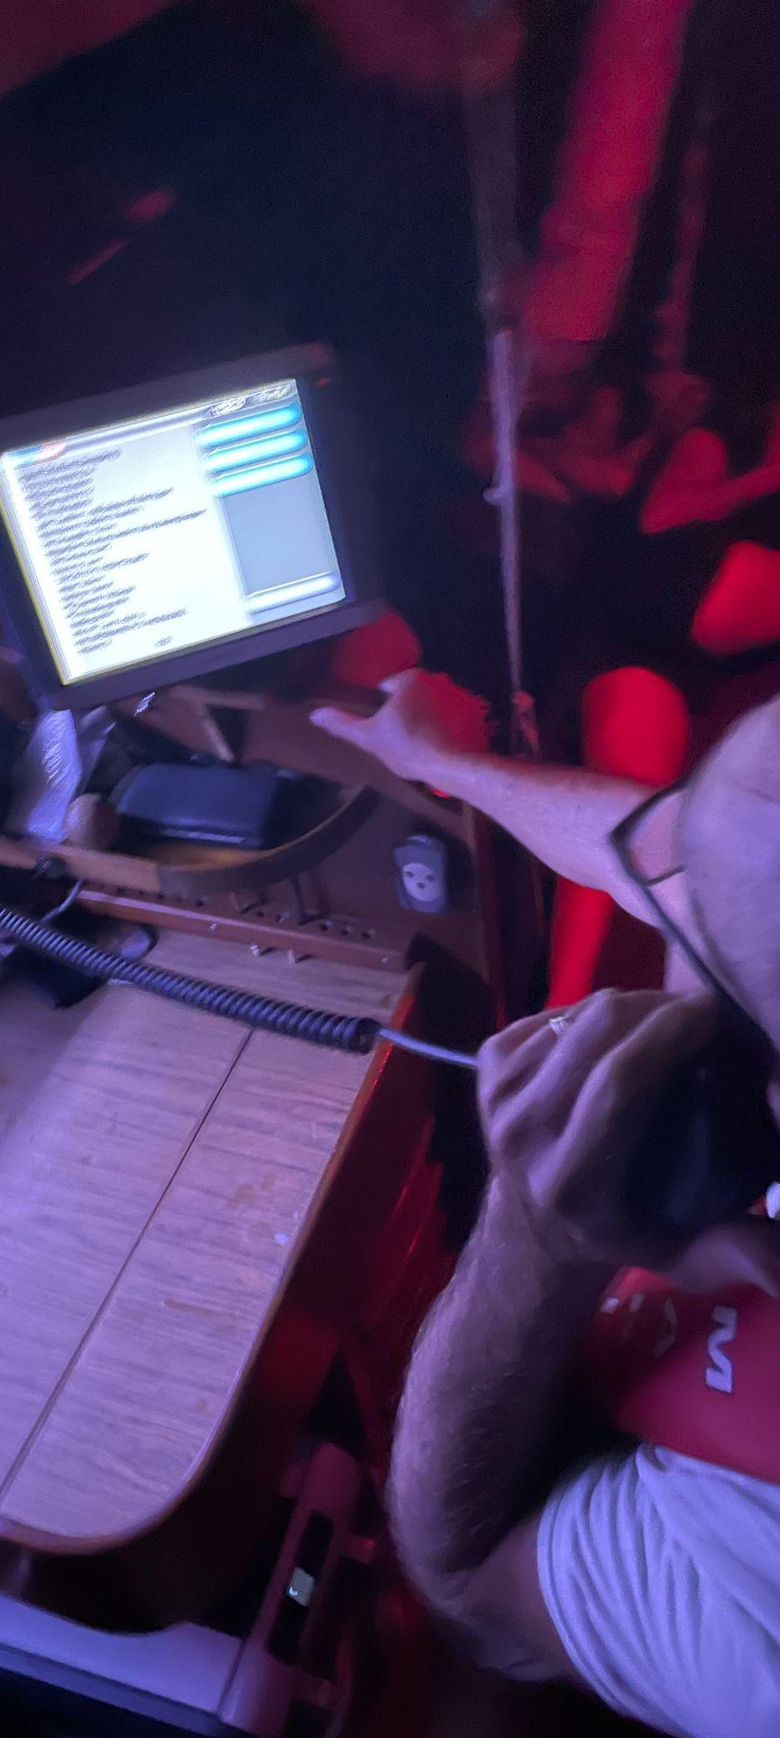
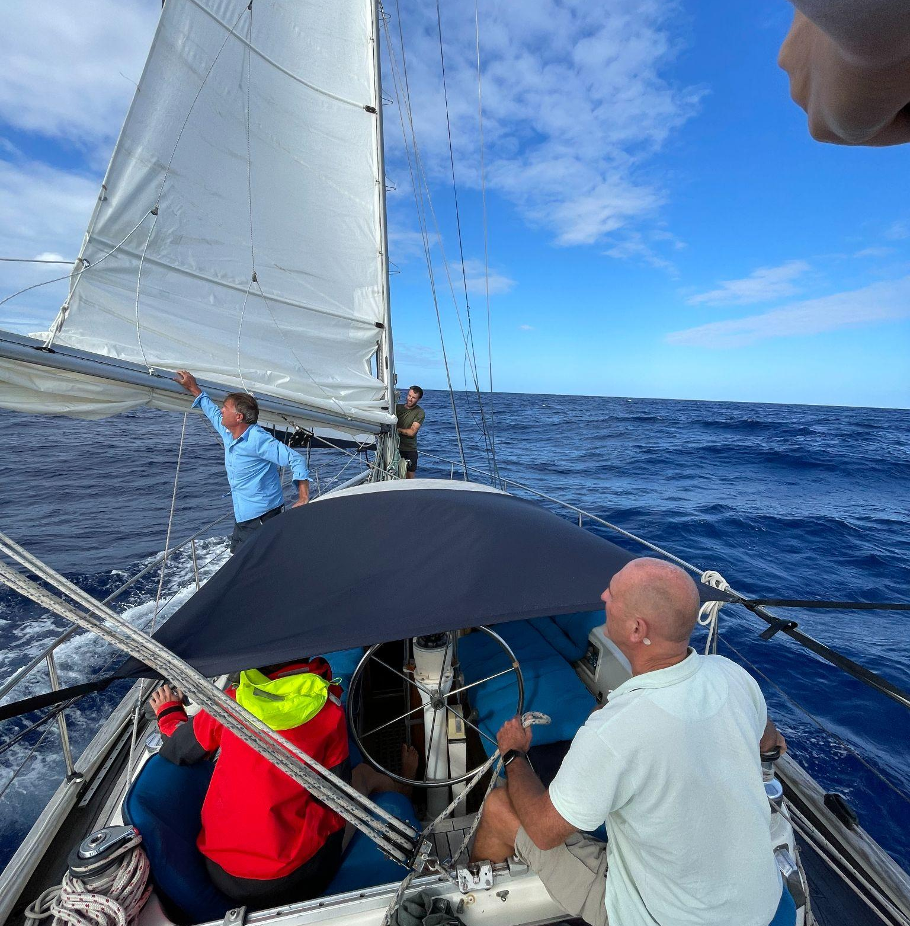
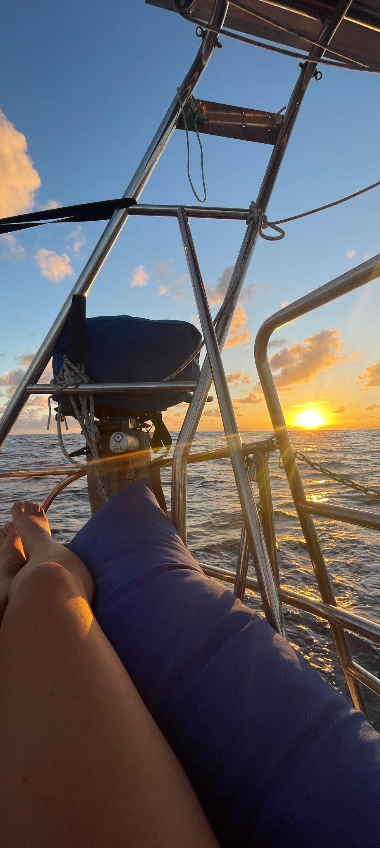
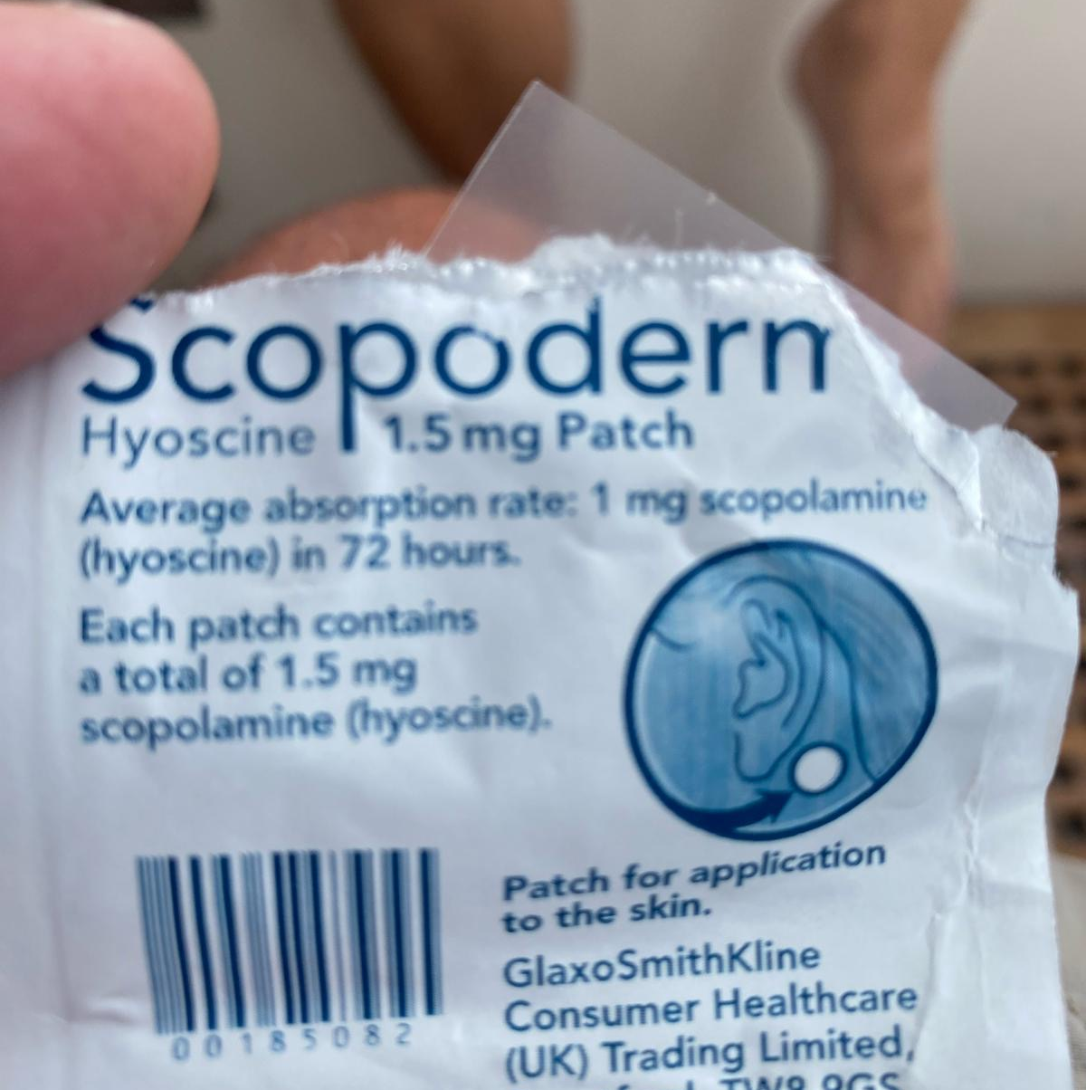
Weather windows, routing, and lessons learned from the crossing.

Slide 10
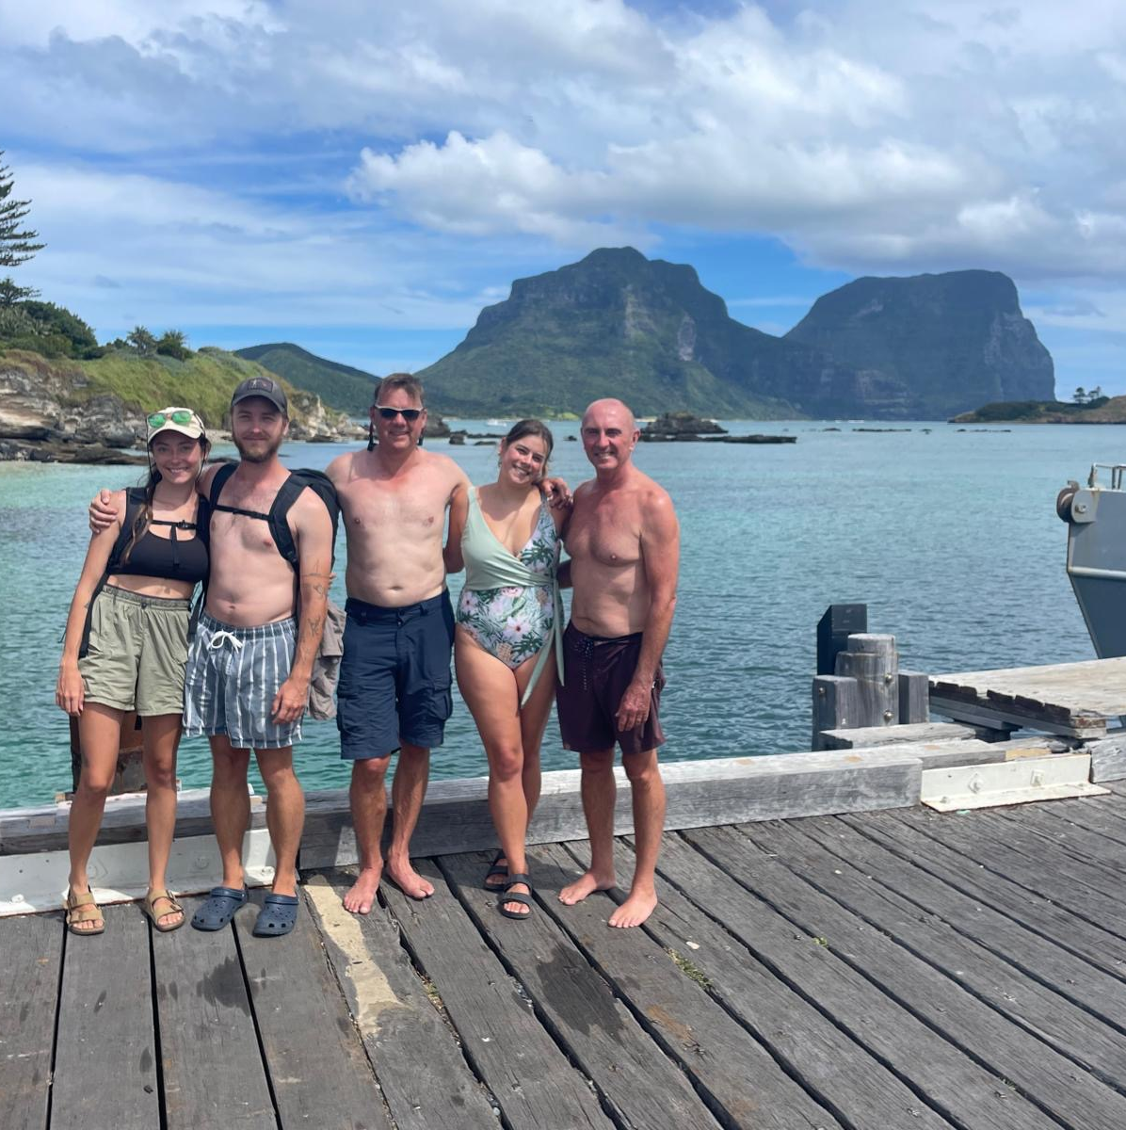
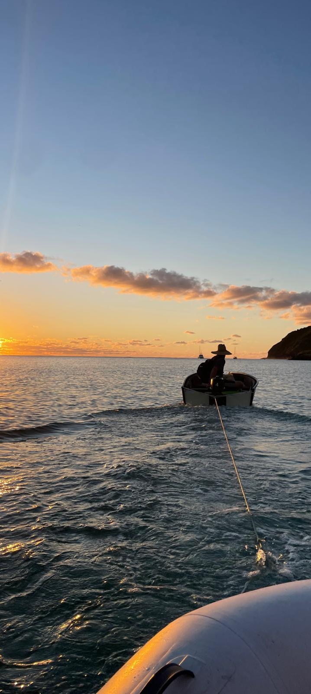
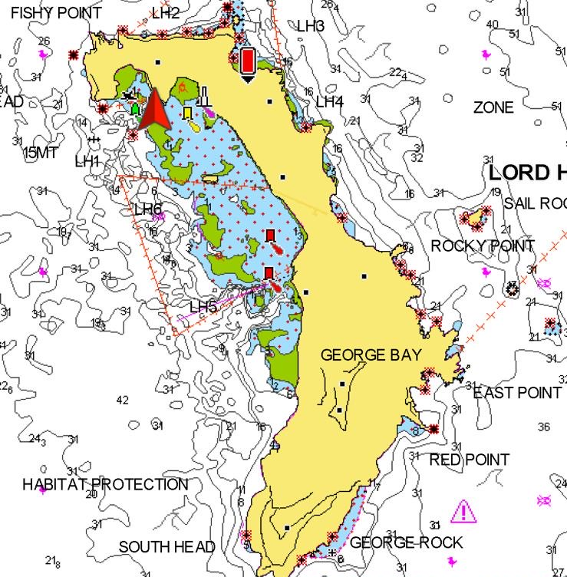
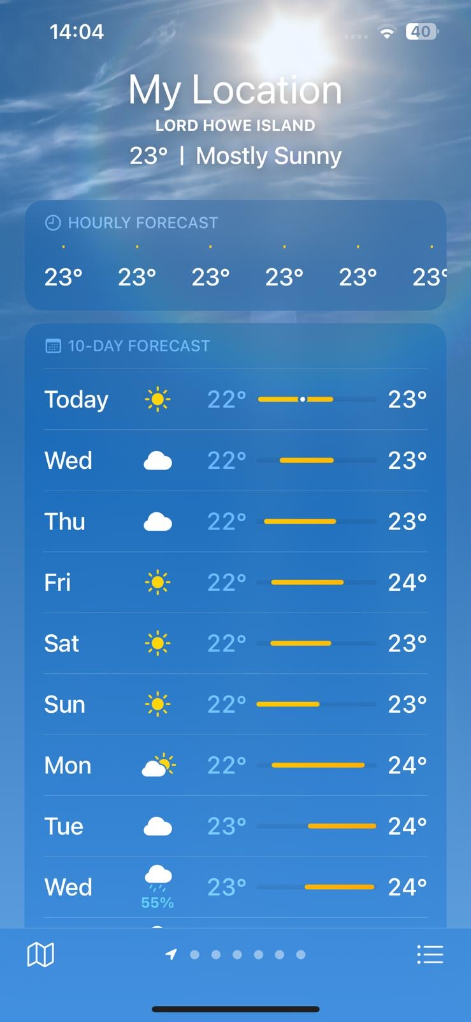
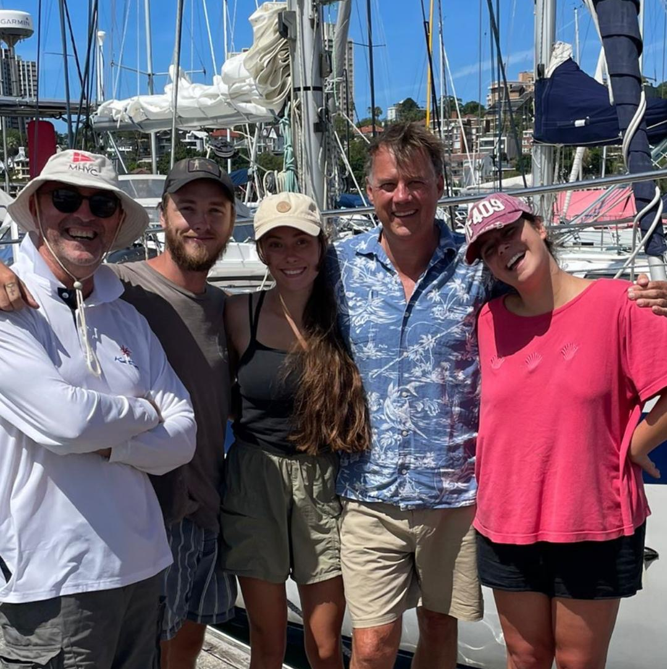
Weather windows, routing, and lessons learned from the crossing.

Slide 11
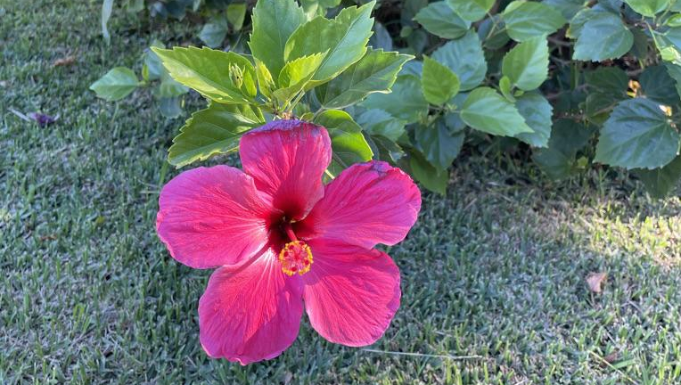
Let’s connect!
Share your contact information.
This can be your work email, your LinkedIn profile, your phone number – wherever you want team members to reach out.
Sammy
Gavin

Slide 12
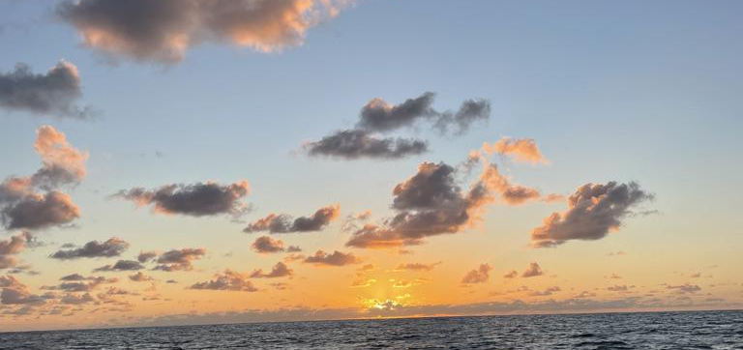
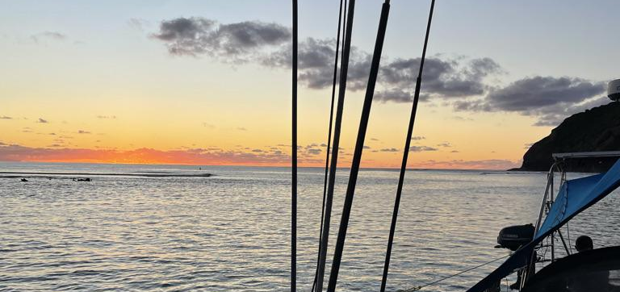
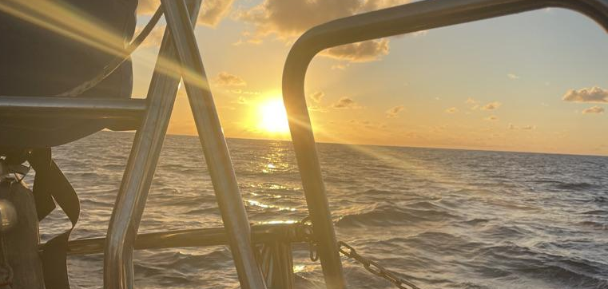
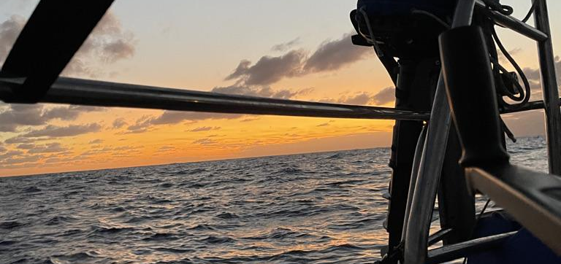
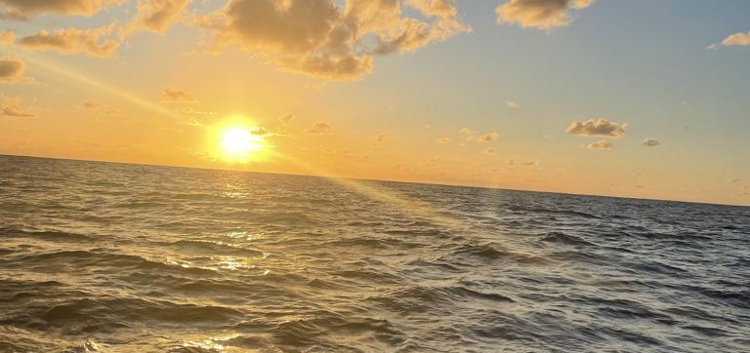
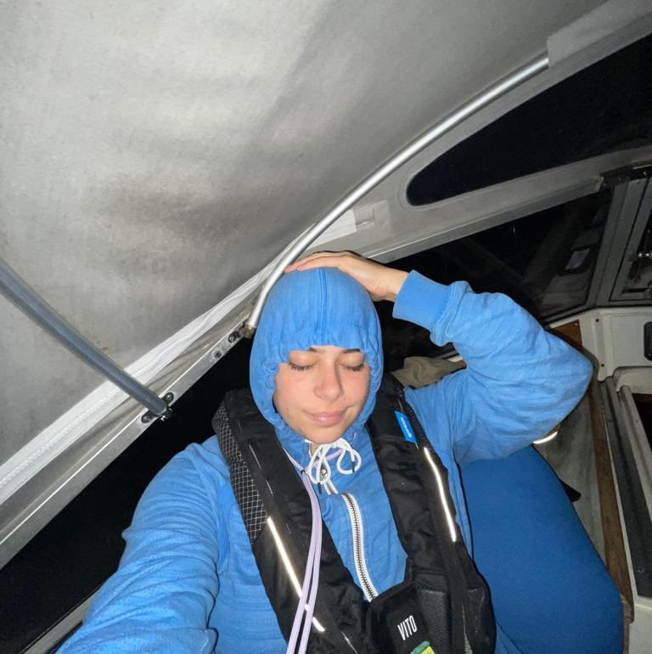
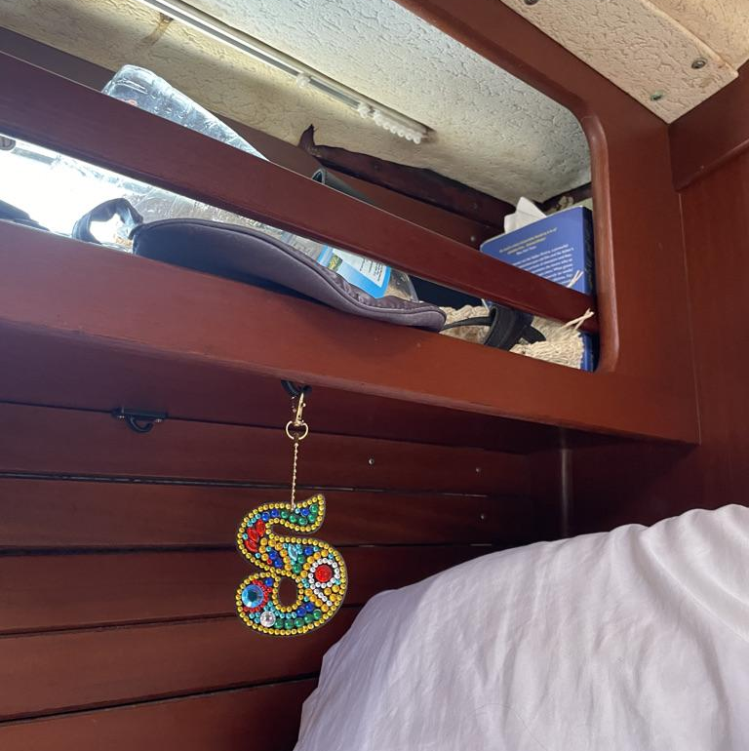
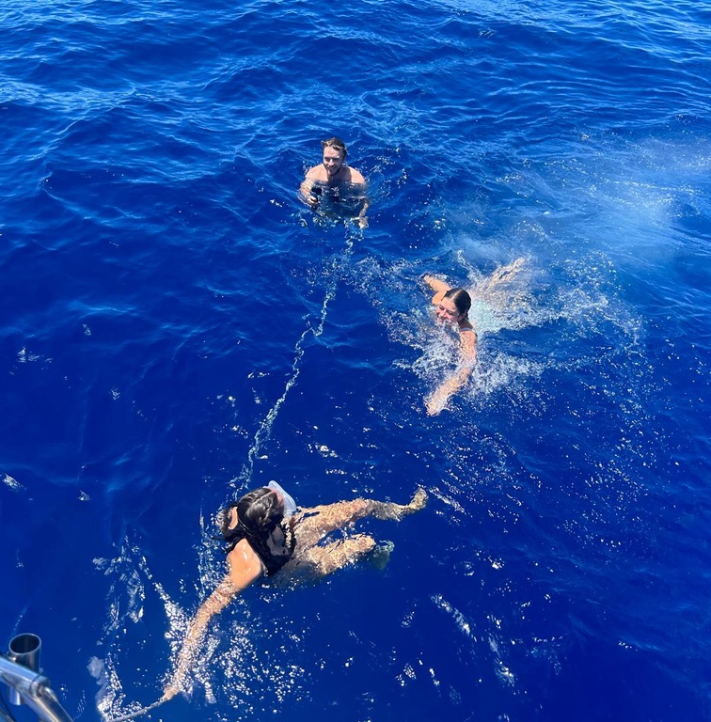
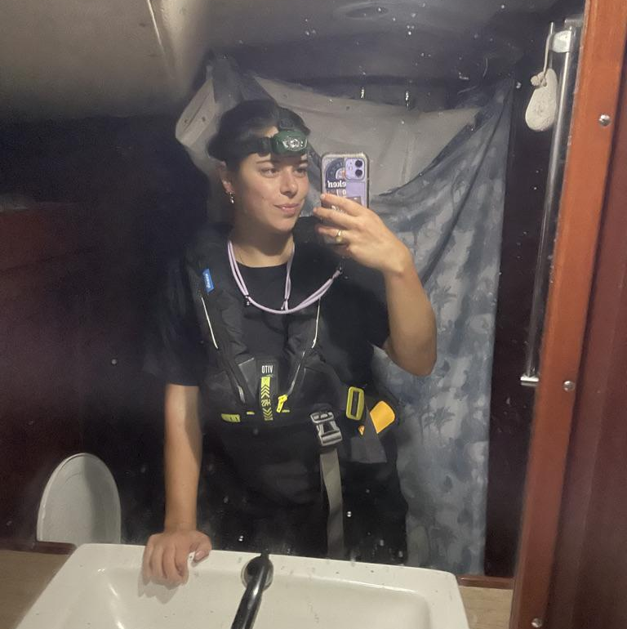
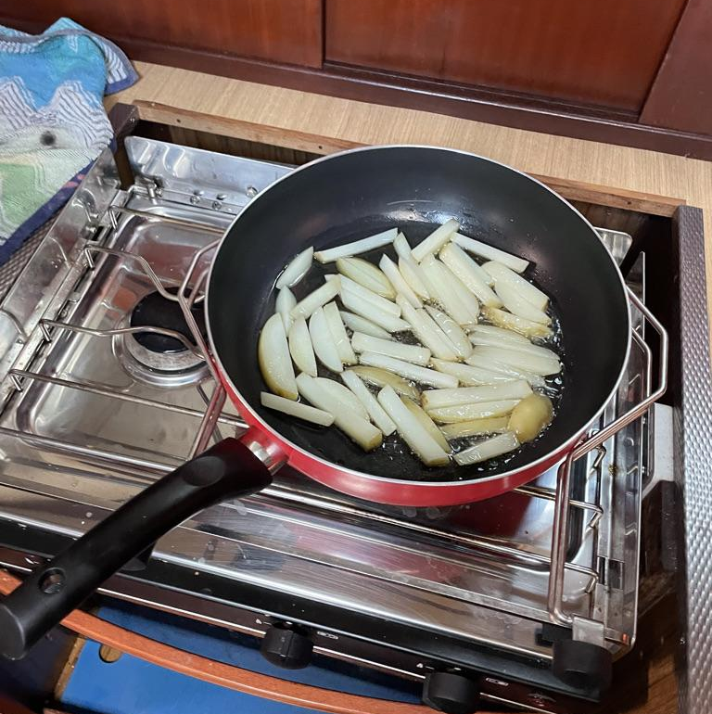
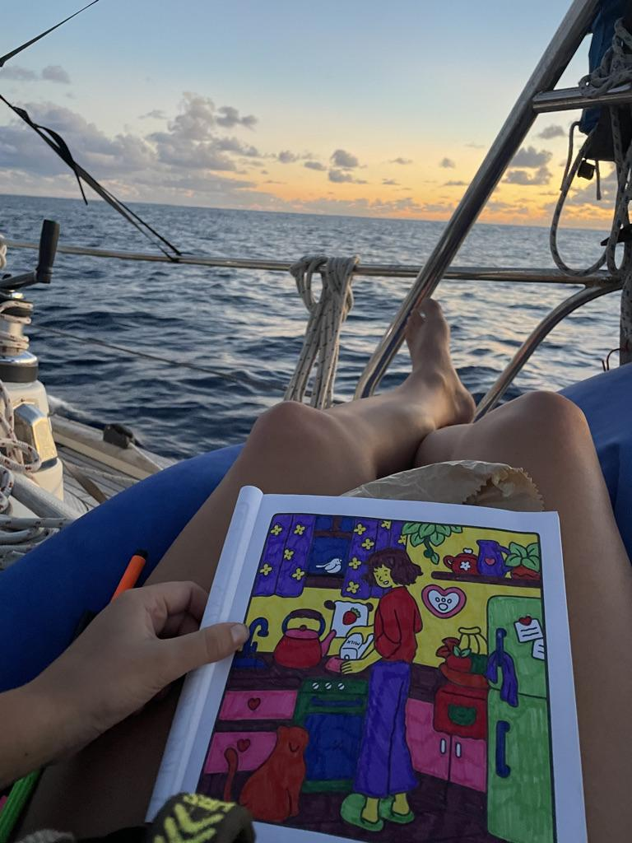
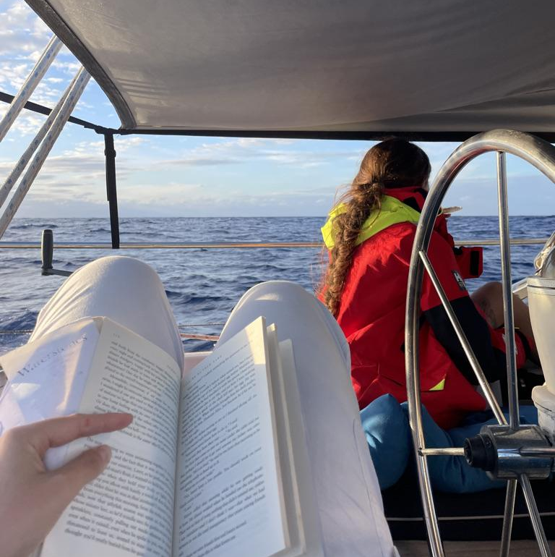

Slide 13
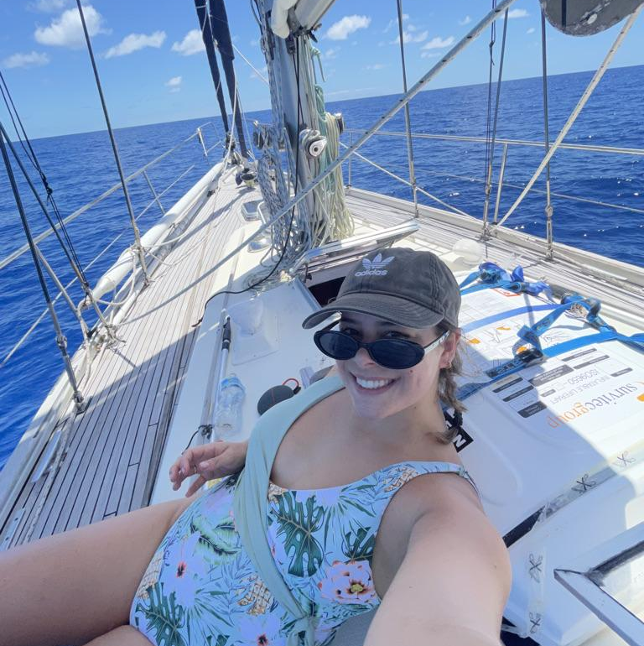
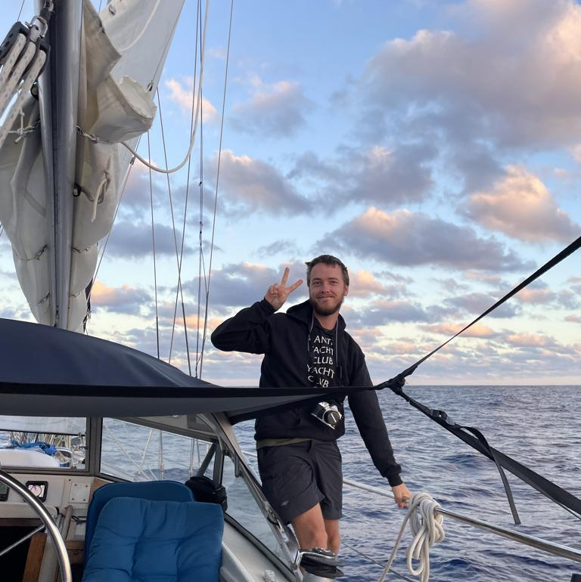
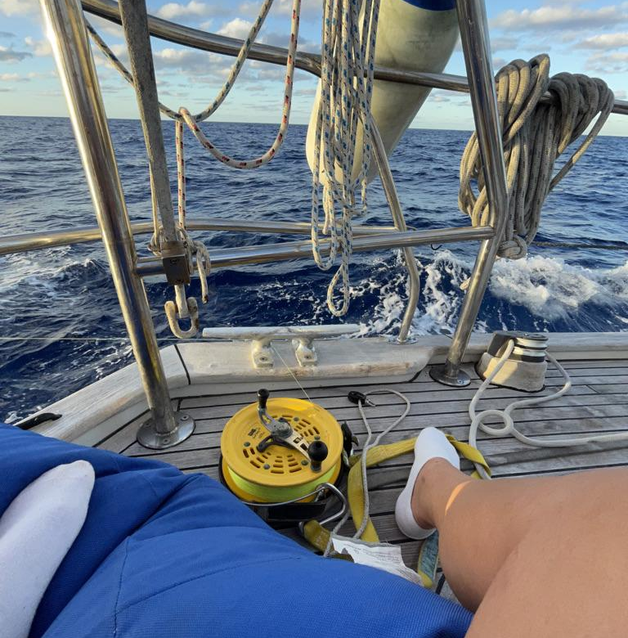
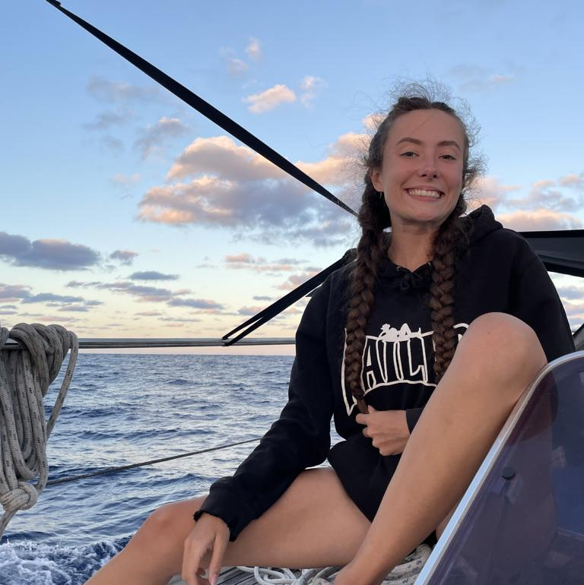
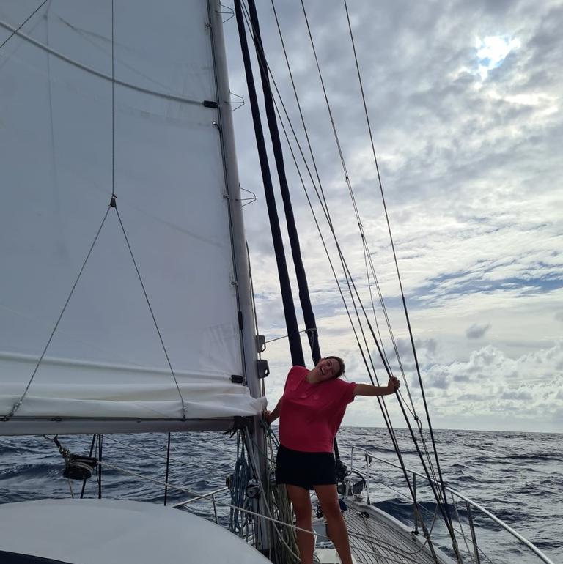
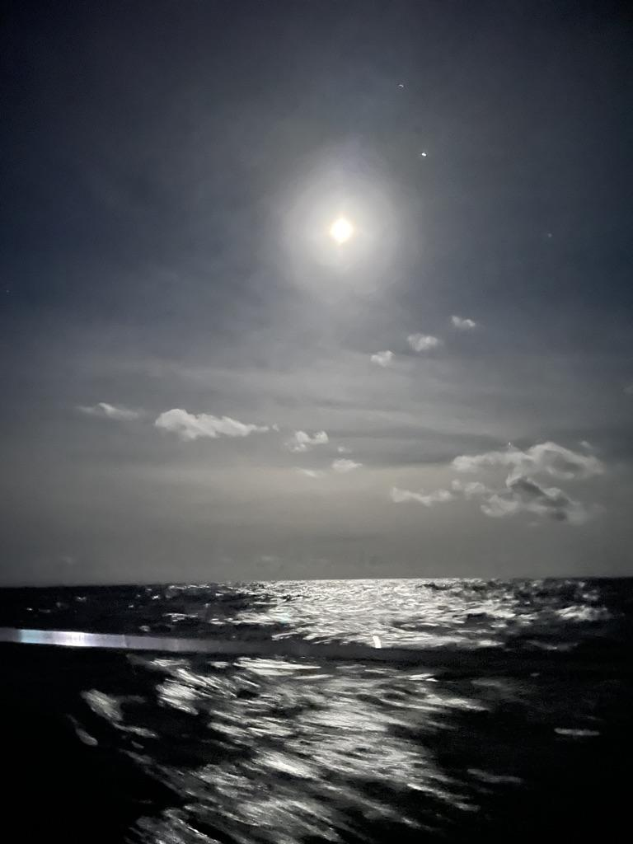
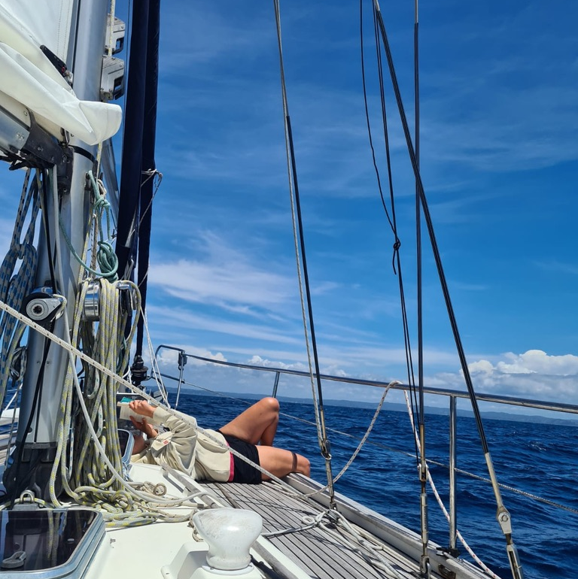
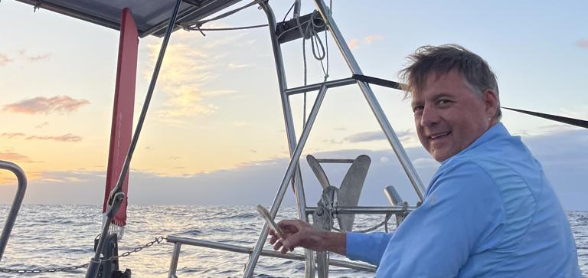





Slide 14












